Slide 1
Module 3.2:
CPU Scheduling

Slide 2
CPU Scheduling
Basic Concepts
Scheduling Criteria
Scheduling Algorithms
Thread Scheduling
Multiple-Processor Scheduling
Real-Time CPU Scheduling
Operating Systems Examples

Slide 3
Objectives
To introduce CPU scheduling, which is the basis for multiprogrammed operating systems
To describe various CPU-scheduling algorithms
To discuss evaluation criteria for selecting a CPU-scheduling algorithm for a particular system
To examine the scheduling algorithms of several operating systems

Slide 4

Basic Concepts
Maximum CPU utilization obtained with multiprogramming
CPU–I/O Burst Cycle – Process execution consists of a cycle of CPU execution and I/O wait
CPU burst followed by I/O burst
CPU burst distribution is of main concern

Slide 5

Histogram of CPU-burst Times

Slide 6
CPU Scheduler
Short-term scheduler selects from among the processes in ready queue, and allocates the CPU to one of them
  Queue may be ordered in various ways
CPU scheduling decisions may take place when a process:
  1. Switches from running to waiting state
  2. Switches from running to ready state
  3. Switches from waiting to ready
  Terminates
Scheduling under 1 and 4 is nonpreemptive
All other scheduling is preemptive
  Consider access to shared data
  Consider preemption while in kernel mode
  Consider interrupts occurring during crucial OS activities

Slide 7
Dispatcher
Dispatcher module gives control of the CPU to the process selected by the short-term scheduler; this involves:
  switching context
  switching to user mode
  jumping to the proper location in the user program to restart that program
Dispatch latency – time it takes for the dispatcher to stop one process and start another running

Slide 8
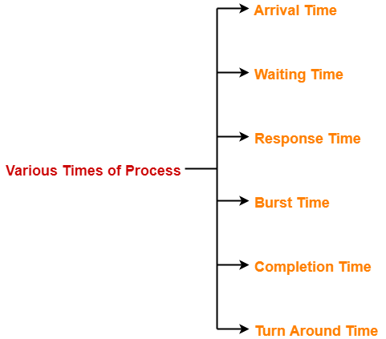

Slide 9
Important CPU scheduling Terminologies
Burst Time/Execution Time: It is a time required by the process to complete execution. It is also called running time.
Arrival Time: when a process enters in a ready state
Finish/Completion Time: when process complete and exit from a system
Multiprogramming: A number of programs which can be present in memory at the same time.
Jobs: It is a type of program without any kind of user interaction.
Process: It is the reference that is used for both job and user.
CPU/IO burst cycle: Characterizes process execution, which alternates between CPU and I/O activity. CPU times are usually shorter than the time of I/O.

Slide 10
Scheduling Criteria
CPU utilization – keep the CPU as busy as possible
Throughput – # of processes that complete their execution per time unit
Turnaround time – amount of time to execute a particular process
Turn Around time = Completion time – Arrival time
Turn Around time = Burst time + Waiting time
Waiting time – amount of time a process has been waiting in the ready queue
Waiting time = Turn Around time – Burst time
Response time – amount of time it takes from when a request was submitted until the first response is produced, not output (for time-sharing environment)
Response Time = Time at which process first gets the CPU – Arrival time

Slide 11
Scheduling Algorithm Optimization Criteria
Max CPU utilization
Max throughput
Min turnaround time
Min waiting time
Min response time

Slide 12
First- Come, First-Served (FCFS) Scheduling
The process which arrives first in the ready queue is firstly assigned the CPU.
In case of a tie, process with smaller process id is executed first.
It is always non-preemptive in nature.
Disadvantages-
It does not consider the priority or burst time of the processes.
It suffers from convoy effect

Slide 13

First- Come, First-Served (FCFS) Scheduling
Process Burst Time
P₁ 24
P₂ 3
P₃ 3
Suppose that the processes arrive in the order: P₁ , P₂ , P₃
The Gantt Chart for the schedule is:
Waiting time for P₁ = 0; P₂ = 24; P₃ = 27
Average waiting time: (0 + 24 + 27)/3 = 17

Slide 14

FCFS Scheduling (Cont.)
Suppose that the processes arrive in the order:
P₂ , P₃ , P₁
The Gantt chart for the schedule is:
Waiting time for P₁ = 6; P₂ = 0; P₃ = 3
Average waiting time: (6 + 0 + 3)/3 = 3
Much better than previous case
Convoy effect - short process behind long process
  Consider one CPU-bound and many I/O-bound processes

Slide 15
FCFS SCHEDULING
Consider the set of 5 processes whose arrival time and burst time are given below-
Process Id | Arrival time | Burst time
P1 | 3 | 4
P2 | 5 | 3
P3 | 0 | 2
P4 | 5 | 1
P5 | 4 | 3
If the CPU scheduling policy is FCFS, calculate the average waiting time and average turn around time.

Slide 16
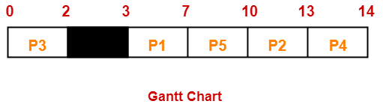

Slide 17
FCFS Solution
Turn Around time = Exit time – Arrival time
Waiting time = Turn Around time – Burst time
Process Id | Exit time | Turn Around time | Waiting time
P1 | 7 | 7 – 3 = 4 | 4 – 4 = 0
P2 | 13 | 13 – 5 = 8 | 8 – 3 = 5
P3 | 2 | 2 – 0 = 2 | 2 – 2 = 0
P4 | 14 | 14 – 5 = 9 | 9 – 1 = 8
P5 | 10 | 10 – 4 = 6 | 6 – 3 = 3
Average Turn Around time = (4 + 8 + 2 + 9 + 6) / 5 = 29 / 5 = 5.8 unit
Average waiting time = (0 + 5 + 0 + 8 + 3) / 5 = 16 / 5 = 3.2 unit

Slide 18
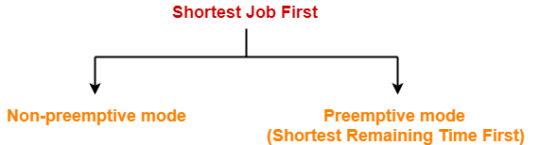
SJF
In SJF Scheduling,
Out of all the available processes, CPU is assigned to the process having smallest burst time.
In case of a tie, it is broken by FCFS Scheduling.

Slide 19
Shortest-Job-First (SJF) Scheduling
Associate with each process the length of its next CPU burst
  Use these lengths to schedule the process with the shortest time
SJF is optimal – gives minimum average waiting time for a given set of processes
  The difficulty is knowing the length of the next CPU request
  Could ask the user

Slide 20

Example of SJF
ProcessArriva l Time Burst Time
P₁ 0.0 6
P₂ 2.0 8
P₃ 4.0 7
P₄ 5.0 3
SJF scheduling chart
Average waiting time = (3 + 16 + 9 + 0) / 4 = 7

Slide 21
SJF Problem
Consider the set of 5 processes whose arrival time and
burst time are given below-
Process Id | Arrival time | Burst time
P1 | 3 | 1
P2 | 1 | 4
P3 | 4 | 2
P4 | 0 | 6
P5 | 2 | 3

Slide 22
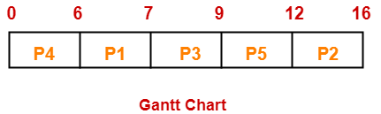
Gantt Chart

Slide 23
Process Id | Exit time | Turn Around time | Waiting time
P1 | 7 | 7 – 3 = 4 | 4 – 1 = 3
P2 | 16 | 16 – 1 = 15 | 15 – 4 = 11
P3 | 9 | 9 – 4 = 5 | 5 – 2 = 3
P4 | 6 | 6 – 0 = 6 | 6 – 6 = 0
P5 | 12 | 12 – 2 = 10 | 10 – 3 = 7
Average Turn Around time = (4 + 15 + 5 + 6 + 10) / 5 = 40 / 5 = 8 unit
Average waiting time = (3 + 11 + 3 + 0 + 7) / 5 = 24 / 5 = 4.8 unit

Slide 24
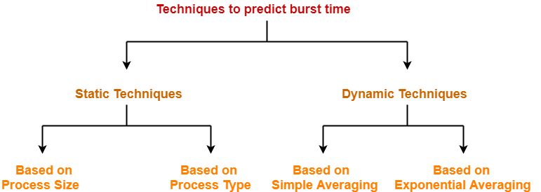

Slide 25
Static Technique
1. Based on Process Size-
This technique predicts the burst time for a process based on its size.
Burst time of the already executed process of similar size is taken as the burst time for the process to be executed.
Example-
Consider a process of size 200 KB took 20 units of time to complete its execution.
Then, burst time for any future process having size around 200 KB can be taken as 20 units.
NOTE
The predicted burst time may not always be right.
This is because the burst time of a process also depends on what kind of a process it is.

Slide 26
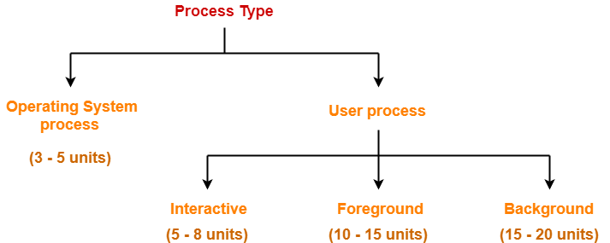
Static Technique
2. Based on Process Type-
This technique predicts the burst time for a process based on its type.

Slide 27
Dynamic Technique
There are two dynamic techniques-
1. Based on simple averaging
2. Based on exponential averaging

Slide 28

Dynamic Technique
1. Based on Simple Averaging-
Burst time for the process to be executed is taken as the average of all the processes that are executed till now.
Given n processes P₁, P₂, … , P_{n} and burst time of each process P_{i} as t_{i}, then predicted burst time for process P_{n+1} is given as-

Slide 29


Determining Length of Next CPU Burst
2. Based on exponential averaging
where-
α is called smoothening factor (0<= α <=1)
t_{n} = actual burst time of process P_{n}
T_{n} = Predicted burst time for process P_{n}
Commonly, α set to ½

Slide 30

Prediction of the Length of the Next CPU Burst

Slide 31
Examples of Exponential Averaging
α =0
  τ_{n+1} = τ_{n}
  Recent history does not count
α =1
  τ_{n+1} = α t_{n}
  Only the actual last CPU burst counts
If we expand the formula, we get:
    τ_{n+1} = α t_{n}+(1 - α)α t_{n} ₋₁ + …
    +(1 - α )^{j} α t_{n} _{-j} + …
    +(1 - α )^{n +1} τ₀
Since both α and (1 - α) are less than or equal to 1, each successive term has less weight than its predecessor

Slide 32
PRACTICE PROBLEM BASED ON PREDICTING BURST TIME-
Calculate the predicted burst time using exponential averaging for the fifth process if the predicted burst time for the first process is 10 units and actual burst time of the first four processes is 4, 8, 6 and 7 units respectively. Given α = 0.5.

Slide 33
Solution
Given-Predicted burst time for 1st process = 10 units
Actual burst time of the first four processes = 4, 8, 6, 7
α = 0.5
Predicted Burst Time for 2nd Process-
= α x Actual burst time of 1st process + (1-α) x Predicted burst time for 1st process
= 0.5 x 4 + 0.5 x 10
= 2 + 5
= 7 units

Slide 34
Solution
Predicted burst time for 3rd process
= α x Actual burst time of 2nd process + (1-α) x Predicted burst time for 2nd process
= 0.5 x 8 + 0.5 x 7
= 4 + 3.5
= 7.5 units
Predicted burst time for 4th process = 6.75 units
5th process = 6.875 units

Slide 35

Example of Shortest-remaining-time-first
Now we add the concepts of varying arrival times and preemption to the analysis
ProcessA arri Arrival TimeT Burst Time
P₁ 0 8
P₂ 1 4
P₃ 2 9
P₄ 3 5
Preemptive SJF Gantt Chart
Average waiting time = [(10-1)+(1-1)+(17-2)+5-3)]/4 = 26/4 = 6.5 msec

Slide 36
SRTF Problem
Process Id | Arrival time | Burst time
P1 | 3 | 1
P2 | 1 | 4
P3 | 4 | 2
P4 | 0 | 6
P5 | 2 | 3
If the CPU scheduling policy is SJF preemptive, calculate the average waiting time and average turn around time.

Slide 37
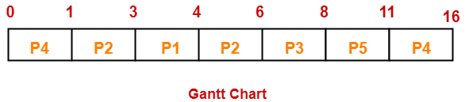
SRTF

Slide 38
SRTF
Process Id | Exit time | Turn Around time | Waiting time
P1 | 4 | 4 – 3 = 1 | 1 – 1 = 0
P2 | 6 | 6 – 1 = 5 | 5 – 4 = 1
P3 | 8 | 8 – 4 = 4 | 4 – 2 = 2
P4 | 16 | 16 – 0 = 16 | 16 – 6 = 10
P5 | 11 | 11 – 2 = 9 | 9 – 3 = 6
Now,
Average Turn Around time = (1 + 5 + 4 + 16 + 9) / 5 = 35 / 5 = 7 unit
Average waiting time = (0 + 1 + 2 + 10 + 6) / 5 = 19 / 5 = 3.8 unit

Slide 39
SRTF
Advantages-
SRTF is optimal and guarantees the minimum average waiting time.
It provides a standard for other algorithms since no other algorithm performs better than it.
Disadvantages-
It can not be implemented practically since burst time of the processes can not be known in advance.
It leads to starvation for processes with larger burst time.
Priorities can not be set for the processes.
Processes with larger burst time have poor response time.

Slide 40
Priority Scheduling
A priority number (integer) is associated with each process
The CPU is allocated to the process with the highest priority (smallest integer ≡ highest priority)
  Preemptive
  Nonpreemptive
SJF is priority scheduling where priority is the inverse of predicted next CPU burst time
Problem ≡ Starvation/Indefinite Blocking – low priority processes may never execute
Solution ≡ Aging – as time progresses increase the priority of the process

Slide 41

Example of Priority Scheduling (Non-Preemptive)
ProcessA arri Burst TimeT Priority
P₁ 10 3
P₂ 1 1
P₃ 2 4
P₄ 1 5
P₅ 5 2
Priority scheduling Gantt Chart
Average waiting time = 8.2 msec

Slide 42
Priority (Preemptive)
If the CPU scheduling policy is priority preemptive, calculate the average waiting time and average turn around time. (Higher number represents higher priority)
Process Id | Arrival time | Burst time | Priority
P1 | 0 | 4 | 2
P2 | 1 | 3 | 3
P3 | 2 | 1 | 4
P4 | 3 | 5 | 5
P5 | 4 | 2 | 5

Slide 43
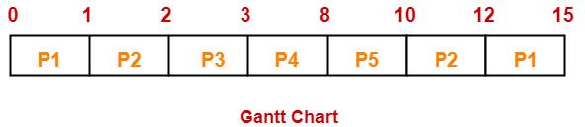
Solution

Slide 44
Solution
Process Id | Exit time | Turn Around time | Waiting time
P1 | 15 | 15 – 0 = 15 | 15 – 4 = 11
P2 | 12 | 12 – 1 = 11 | 11 – 3 = 8
P3 | 3 | 3 – 2 = 1 | 1 – 1 = 0
P4 | 8 | 8 – 3 = 5 | 5 – 5 = 0
P5 | 10 | 10 – 4 = 6 | 6 – 2 = 4
Now,
Average Turn Around time = (15 + 11 + 1 + 5 + 6) / 5 = 38 / 5 = 7.6 unit
Average waiting time = (11 + 8 + 0 + 0 + 4) / 5 = 23 / 5 = 4.6 unit

Slide 45
Round Robin (RR)
Each process gets a small unit of CPU time (time quantum q), usually 10-100 milliseconds. After this time has elapsed, the process is preempted and added to the end of the ready queue.
If there are n processes in the ready queue and the time quantum is q, then each process gets 1/n of the CPU time in chunks of at most q time units at once. No process waits more than (n-1)q time units.
Timer interrupts every quantum to schedule next process
Performance
  q large ⇒ FIFO
  q small ⇒ q must be large with respect to context switch, otherwise overhead is too high

Slide 46
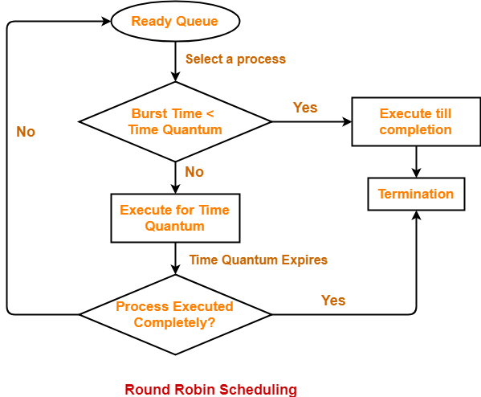
Round Robin (RR)

Slide 47
Round Robin (RR)
Advantages-
It gives the best performance in terms of average response time.
It is best suited for time sharing system, client server architecture and interactive system.
Disadvantages-
It leads to starvation for processes with larger burst time as they have to repeat the cycle many times.
Its performance heavily depends on time quantum.
Priorities can not be set for the processes.

Slide 48

Example of RR with Time Quantum = 4
Process Burst Time
P₁ 24
P₂ 3
P₃ 3
The Gantt chart is:
Typically, higher average turnaround than SJF, but better response
q should be large compared to context switch time
q usually 10ms to 100ms, context switch < 10 usec

Slide 49

Time Quantum and Context Switch Time

Slide 50

Turnaround Time Varies With The Time Quantum
80% of CPU bursts should be shorter than q

Slide 51
MIXED BURST TIME EXAMPLE
Refer the example taken in lecture

Slide 52
Multilevel Queue
Ready queue is partitioned into separate queues, eg:
  foreground (interactive)
  background (batch)
Process permanently in a given queue
Each queue has its own scheduling algorithm:
  foreground – RR
  background – FCFS
Scheduling must be done between the queues:
  Fixed priority scheduling; (i.e., serve all from foreground then from background). Possibility of starvation.
  Time slice – each queue gets a certain amount of CPU time which it can schedule amongst its processes; i.e., 80% to foreground in RR
  20% to background in FCFS

Slide 53

Multilevel Queue Scheduling

Slide 54
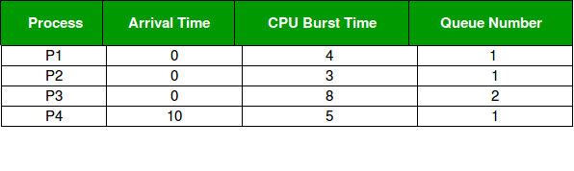
MLQ Example
Priority of queue 1 is greater than queue 2.
queue 1 uses Round Robin (Time Quantum = 2) and queue 2 uses FCFS.

Slide 55

Gantt Chart
Working:
At starting, both queues have process so process in queue 1 (P1, P2) runs first (because of higher priority) in the round robin fashion and completes after 7 units
Then process in queue 2 (P3) starts running (as there is no process in queue 1) but while it is running P4 comes in queue 1 and interrupts P3 and start running for 5 second and
After its completion P3 takes the CPU and completes its execution.

Slide 56
Multilevel Feedback Queue
A process can move between the various queues; aging can be implemented this way
Multilevel-feedback-queue scheduler defined by the following parameters:
  number of queues
  scheduling algorithms for each queue
  method used to determine when to upgrade a process
  method used to determine when to demote a process
  method used to determine which queue a process will enter when that process needs service

Slide 57

Example of Multilevel Feedback Queue

Slide 58
MLFQ
Three queues:
  Q₀ – RR with time quantum 8 milliseconds
  Q₁ – RR time quantum 16 milliseconds
  Q₂ – FCFS
Scheduling
  A new job enters queue Q₀ which is served FCFS
    When it gains CPU, job receives 8 milliseconds
    If it does not finish in 8 milliseconds, job is moved to queue Q₁
  At Q₁ job is again served FCFS and receives 16 additional milliseconds
    If it still does not complete, it is preempted and moved to queue Q₂

Slide 59

Real-Time CPU Scheduling
Can present obvious challenges
Soft real-time systems – no guarantee as to when critical real-time process will be scheduled
Hard real-time systems – task must be serviced by its deadline
Two types of latencies affect performance
  Interrupt latency – time from arrival of interrupt to start of routine that services interrupt
  Dispatch latency – time for schedule to take current process off CPU and switch to another

Slide 60

Real-Time CPU Scheduling (Cont.)
Conflict phase of dispatch latency:
  Preemption of any process running in kernel mode
  Release by low-priority process of resources needed by high-priority processes

Slide 61
GATE QUESTIONS (1)
Consider three CPU-intensive processes, which require 10, 20 and 30 time units and arrive at times 0, 2 and 6, respectively. How many context switches are needed if the operating system implements a shortest remaining time first scheduling algorithm? Do not count the context switches at time zero and at the end.
(A) 1
(B) 2
(C) 3
(D) 4

Slide 62
GATE QUESTIONS (2)
An operating system uses shortest remaining time first scheduling algorithm for pre-emptive scheduling of processes. Consider the following set of processes with their arrival times and CPU burst times (in milliseconds):
Process Arrival Time Burst Time
P1 0 12
P2 2 4
P3 3 6
P4 8 5
The average waiting time (in milliseconds) of the processes is _________.

Slide 63
End of Chapter

